Slide 1
Macroeconomics
Depressions

Slide 2
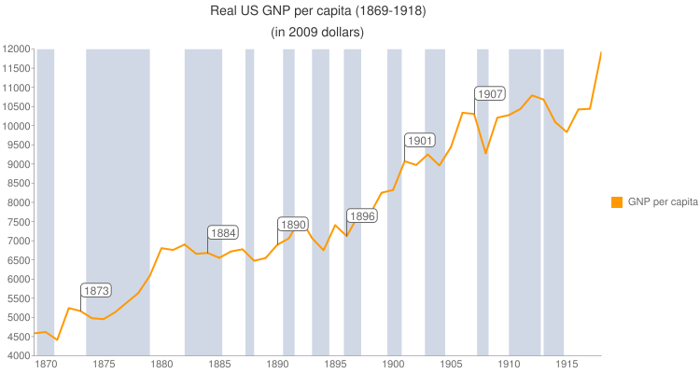
Depressions happen
http://www.nber.org/cycles.html

Slide 3
What is a depression?
What is a recession?
NBER: “A recession is a significant decline in economic activity …, lasting more than a few months, normally visible in production, employment, real income, and other indicators.
“A recession begins when the economy reaches a peak of activity and ends when the economy reaches its trough. Between trough and peak, the economy is in an expansion.”

Slide 4
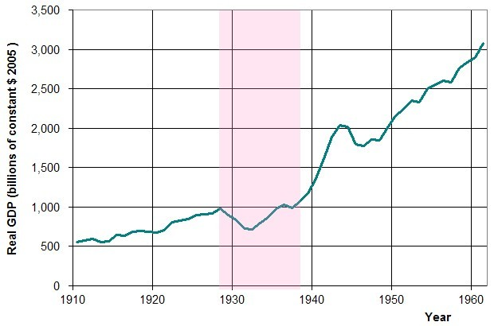
But the economy is “depressed” (general parlance) for much of the “expansion” (NBER’s parlance)

Slide 5
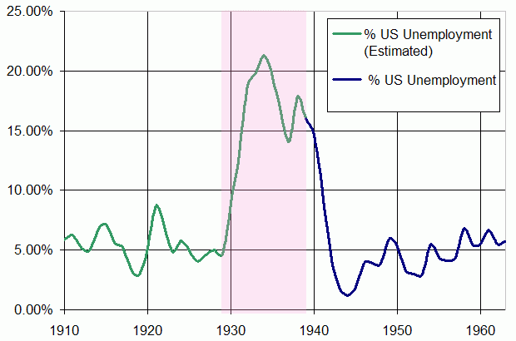
But the economy is “depressed” (general parlance) for much of the “expansion” (NBER’s parlance)

Slide 6
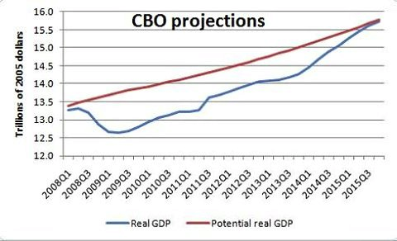
But the economy is “depressed” (general parlance) for much of the “expansion” (NBER’s parlance)
Total output lost: $5 trillion

Slide 7
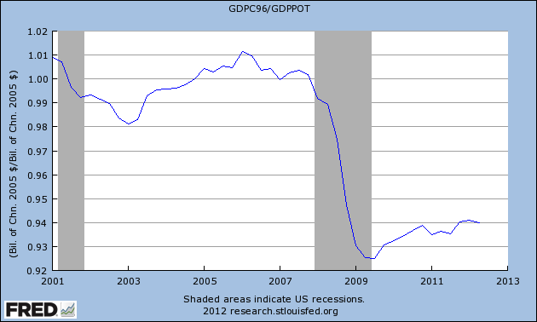
GDP / Potential GDP

Slide 8
Why do depressions happen?
Because the government messes up? – No!
  Or not really
Any economy based on money can collapse spontaneously

Slide 9
Money
Money has two roles
  Medium of exchange
  Store of value
  The basic problem that leads to depressions:
You can store money
But you can’t store labor

Slide 10
Money
Money has two roles
  Medium of exchange (money flows)
  Store of value (money can be stockpiled)
  The basic problem:
You can store (stockpile) money.
But you can’t store labor. (Labor only flows.)

Slide 11
Depression real-life model:
The DC babysitting cooperative
Large coop in the 1970s for exchange of babysitting services among Congressional staffers

Slide 12
Depression real-life model:
The DC babysitting cooperative
Large coop in the 1970s for exchange of babysitting services among Congressional staffers
Members got coupons.
Give coupon to hire another member as a babysitter.

Slide 13
Depression real-life model:
The DC babysitting cooperative
Large coop in the 1970s for exchange of babysitting services among Congressional staffers
Members got coupons.
Give coupon to hire another member as a babysitter.
Then some members decided to save coupons for future use.

Slide 14
Depression real-life model:
The DC babysitting cooperative
Members got coupons.
Give coupon to hire another member as a babysitter.
Then some members decided to save coupons for future use.
It became harder to find a babysitting job and earn a coupon.

Slide 15
Depression real-life model:
The DC babysitting cooperative
Give coupon to hire another member as a babysitter.
Then some members decided to save coupons for future use.
It became harder to find a babysitting job and earn a coupon.
More members saved their coupons
  Feared that they wouldn’t be able to go out later

Slide 16
Depression real-life model:
The DC babysitting cooperative
Some members decided to save coupons
It became harder to find a babysitting job and earn a coupon.
More members who had coupons saved them
  feared that they wouldn’t be able to earn replacement coupons
Members who had used all their coupons couldn’t earn coupons.

Slide 17
Depression real-life model:
The DC babysitting cooperative
Members saving coupons led to …
… self-reinforcing panic among members with coupons
… widespread unemployment

Slide 18
Depression economics – common sense upside-down
Thrift a virtue?
  Paradox of thrift
Better skills needed? Babysitter training program?

Slide 19
What solved the depression
Giving out certificates
  Solved the baby sitting coop depression
Giving out money
  Solved the Great Depression
  A failure to give out money has prolonged the current depression.

