Slide 1
Pharmaceuticals
HSPM 714 J50
Fall 2013

Slide 2
What is the real product of the drug industry?
Drugs?
New drugs?
Prices >> marginal cost of production
  for brand name drugs

Slide 3
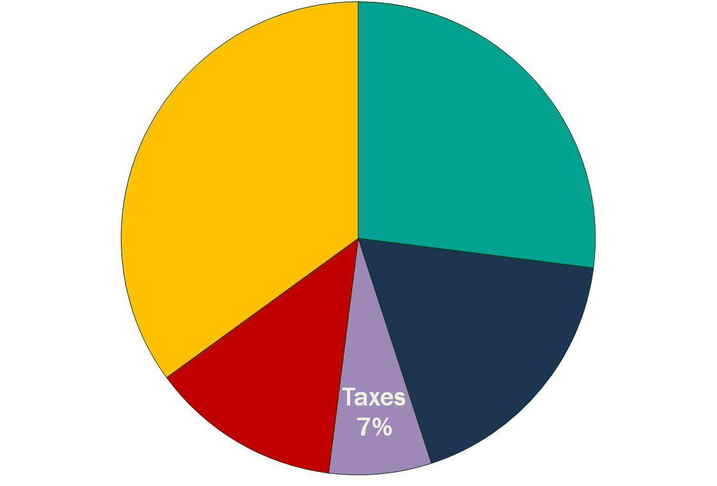
Drug Companies’ Cost Structure
Marketing and Admin
35%
Manufacturing
27%
Profits
(After Taxes)
18%
R&D
13%
Source: Health Affairs 2001;20(5):136
Source: Health Affairs 2001;20(5):136

Slide 4
Why are brand-name drug prices so much higher than production cost?
WRONG: Industry passes R&D cost on in the price.
RIGHT: Demand determines the price. Industry spends on R&D to create drugs that can be sold at a high price.

Slide 5
Profits and innovation
Today's profits do not pay for yesterday's research.
Yesterday's research costs do not determine today's drug prices.
Rather, today's drug prices are set by what the market will bear, and the research and development effort adjusts.

Slide 6
What do drug industry profits do?
Today's profits are not the fund that pays for tomorrow's research.
  Established drug firms do pay for research out of their operating profit, but many biotechnology startup companies raise capital by borrowing or selling stock. If the expected returns were good enough, the drug companies could do that, too.
What today's profits do: influence expectations about tomorrow's profits. Expected future profit induces today's research and development.

Slide 7
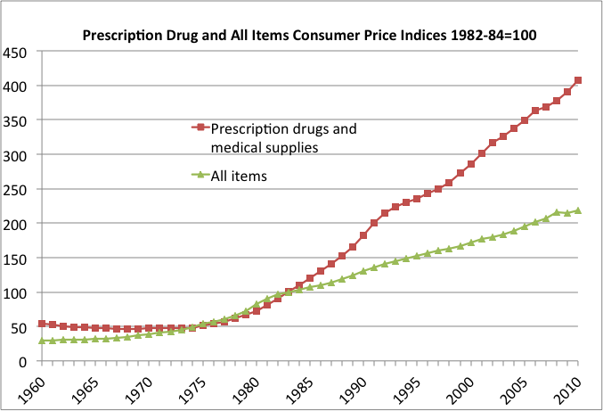

Slide 8
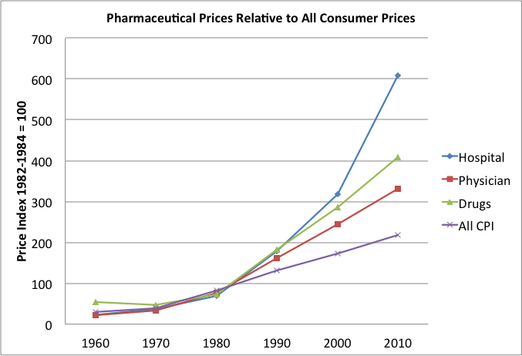

Slide 9
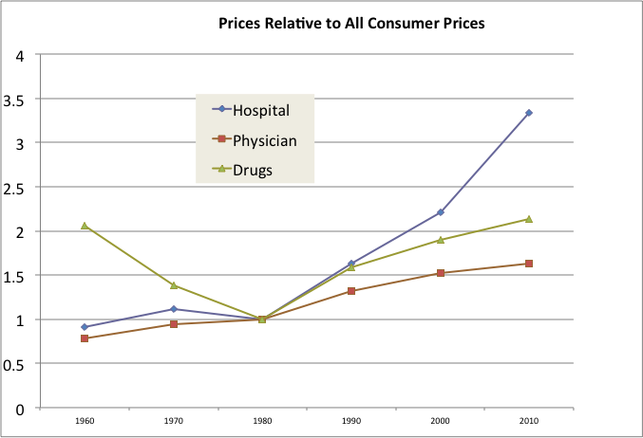

Slide 10
Example, from Angell
‘… the price of Schering-Plough’s top-selling allergy pill, Claritin, was raised thirteen times over five years, for a cumulative increase of more than 50 percent—over four times the rate of general inflation.² As a spokeswoman for one company explained, “Price increases are not uncommon in the industry and this allows us to be able to invest in R&D.”’

Slide 11
R&D (almost) expands to meet profit opportunity
  U.S. Congress, Office of Technology Assessment, Pharmaceutical R&D: Costs, Risks, and Rewards, OTA-H-522 (Washington, DC: U.S. Government Printing Office, February 1993)
Pharmaceutical R&D* is risky and requires extra return. (* D includes education.)
Pharmaceutical companies made more profit than necessary to compensate them for the risk, but only by 4.3% of drug prices, on average.

Slide 12
Would limiting drug prices reduce innovation?
The danger of forcing drug prices down today is that drug firms will expect less payoff from drugs in the future. They will reduce research and development accordingly.
What's unclear, though, is how much that research reduction will be, and whether any reduction would retard actual scientific advance, as opposed to the pursuit of "me-too" drugs.

Slide 13
Angell’s critique:
“Me too” drugs
Little or no therapeutic difference with existing drugs.
Doctors can be persuaded to prescribe them anyway.
Only some price competition.

Slide 14
Net Cost
------------------- is the cost-effectiveness measure
QALY
Cost = Price × Quantity – Saved treatment cost
$135.45×Quantity – Saved treatment cost
--------------------------------------------- = $43,600/qg
QALYs gained
($135.45 is for one HPV Quad)

Slide 15
Our government’s systems for encouraging drug innovation
Patents
Regulation

Slide 16
Patents
U.S. Constitution, Article I, section 8:
Congress shall have Power … [to do several things, including] To promote the Progress of Science and useful Arts, by securing for limited Times to Authors and Inventors the exclusive Right to their respective Writings and Discoveries; …

Slide 17
Patents’ purpose
Patents induce invention
  by the prospect of profit during the monopoly period.
Patents help disseminate technology
  by making patents public documents
  and by ending the monopoly after a set number of years.

Slide 18
What gets a patent
  A patent can be granted for
“any new and useful art, machine, manufacture or composition of matter and any new and useful improvement on any art, machine, manufacture or composition of matter.”
  Secretary of State Thomas Jefferson, 1793

Slide 19
Relevant to the drug industry
Product patent
  A new drug entity (invented molecule or mixture)
Process patent
  A new method for manufacturing a drug entity
Use patent

Slide 20
Patents terminology
PATENT
Granted by the U.S. Patent and Trademark Office (USPTO).
Gives the owner the right to exclude others from making, using, or selling an invention for a fixed period of time.
Requires that the details of the invention be made public.
PATENT LIFE or PATENT TERM
The period of time during which a patent is in effect. Currently 20 years, beginning on the date of application to the USPTO.
EFFECTIVE PATENT LIFE
Portion of the patent term that remains after clinical testing and FDA review.

Slide 21
Intellectual Property Protection (IPP) Tactics
As a drug’s patent nears expiration …
EVERGREENING
Patenting additional uses of a drug or a “purified” form of the drug.
“PURIFIED” DRUG
Alter a drug’s molecular structure, supposedly to enhance effectiveness or to reduce side effects and dangerous interactions.

Slide 22
Intellectual Property Protection (IPP) through the FDA
MARKET EXCLUSIVITY
A special form of IPP conferred only on qualifying prescription drugs.
Prevents the FDA from approving the same new use of a drug for a competing manufacturer for a specified period of time.
Sometimes called data exclusivity.

Slide 23
Regulation
1906 Pure Food and Drug Act.
  "U.S.P." standard established for purity.
  No safety or efficacy requirement.
  Required labeling of products containing certain specified drugs, including alcohol, cocaine, heroin, morphine, and cannabis
Upton Sinclair, The Jungle, 1906
  “I aimed for America's heart, but I hit its stomach.”

Slide 24
Regulation
1938 Federal Food, Drug, and Cosmetics Act
Created the Food and Drug Administration (FDA).
Marketing new drug has since required prior approval of New Drug Application (NDA).
Safety was the criterion for approval.
  1937 -- an elixir of Sulfanilamide dissolved in ethylene glycol killed over 100 children

Slide 25
Invention of modern drug marketing
Aureomycin 1948
  American Cyanamid
Fawning ghost-written articles in magazines
Direct mailings to doctors
Samples

Slide 26
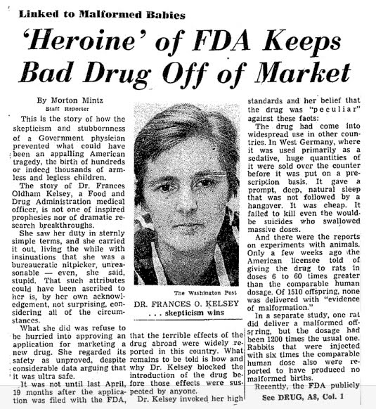
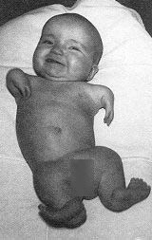
1962: Regulation tightened
Notes:
Thalidomide was a sedative widely marketed over the counter in Europe. In 1960, Richardson-Merrill got a US license from the European patent holder, filed an NDA, and, as part of the testing that was then allowed under the 1938 act, distributed 2.5 million doses of the drug to 1300 physicians for a "clinical testing" program that was more like pre-promotion. At that time, an NDA was automatically approved in 60 days unless negative evidence appeared. FDA could extend review for up to 120 days more.
The heroine was Dr. Francis O. Kelsey of the FDA, handling her first NDA. Concerned about reports of tingling sensations in the extremities, she delayed approving the Thalidomide NDA for the maximum period, then concocted further bureaucratic delays to keep Thalidomide off the market, despite daily visits from Merrill lobbyists, and a letter from Merrill calling her complaints about false data on Merrill's NDA "libellous." By late 1961, investigators in West Germany had linked Thalidomide with a severe birth defect, phocomelia. 5900 cases in W. Ger. Had it not been for Dr. Kelsey, there might have been 10,000 cases in the US. Instead there were 10, from Merrill's loosely controlled clinical testing program. It took months to inform the medical profession and recover the Thalidomide samples. JFK gave Kelsey the Distinguished Federal Civilian Service medal.

Slide 27
1962: Regulation tightened
  1960-62 Thalidomide incident sparked the 1962 Kefauver-Harris Amendments
Positive NDA approval required, no time limit
Proof of efficacy required, in addition to proof of safety
Retroactive efficacy proof required for post-1938 drugs
  Led to removals from market of about 90 senseless drugs, like antibiotics in combination.
Clinical testing tightened
  animal tests first
  then IND (Investigational New Drug) application
  controlled clinical tests by qualified investigators
Advertising restrictions
  generic name must appear
  side-effects and contraindications
  therapeutic claims cannot exceed evidence submitted to FDA
Notes:
Thalidomide was a sedative widely marketed over the counter in Europe. In 1960, Richardson-Merrill got a US license from the European patent holder, filed an NDA, and, as part of the testing that was then allowed under the 1938 act, distributed 2.5 million doses of the drug to 1300 physicians for a "clinical testing" program that was more like pre-promotion. At that time, an NDA was automatically approved in 60 days unless negative evidence appeared. FDA could extend review for up to 120 days more.
The heroine was Dr. Francis O. Kelsey of the FDA, handling her first NDA. Concerned about reports of tingling sensations in the extremities, she delayed approving the Thalidomide NDA for the maximum period, then concocted further bureaucratic delays to keep Thalidomide off the market, despite daily visits from Merrill lobbyists, and a letter from Merrill calling her complaints about false data on Merrill's NDA "libellous." By late 1961, investigators in West Germany had linked Thalidomide with a severe birth defect, phocomelia. 5900 cases in W. Ger. Had it not been for Dr. Kelsey, there might have been 10,000 cases in the US. Instead there were 10, from Merrill's loosely controlled clinical testing program. It took months to inform the medical profession and recover the Thalidomide samples. JFK gave Kelsey the Distinguished Federal Civilian Service medal.

Slide 28
Attack on regulation began in late 1960s
New FDA process made pharmaceutical innovation more costly
While reducing the future income stream by using up some of the patent years
Drug prices determined by demand elasticity – what market will bear

Slide 29
Alleged consequences of regulation’s cost and time
… Promising drugs are not developed, or our access to them is delayed
Oft-cited example: benzodiazepine hypnotics.
  Available in the U.S. 5 years after available in Europe.
  Estimate of 1200 deaths from reactions to barbiturates during those years that would not have happened had drugs of this class been available.

Slide 30
Hatch-Waxman Act
The Drug Price Competition and Patent Term Restoration Act of 1984
Generics can win FDA approval by submitting bioequivalence studies, as opposed to clinical trials data.
Grants patented drugs up to 5 years of additional marketing exclusivity to make up for the time consumed by the clinical trials and approval process.

Slide 31
Prescription Drug User Fee Act (PDUFA)
Enacted 1992, renewed in 1997, 2002, 2007.
FDA can collect fees from companies that produce certain human drug and biological products to help pay for reviewers.

Slide 32
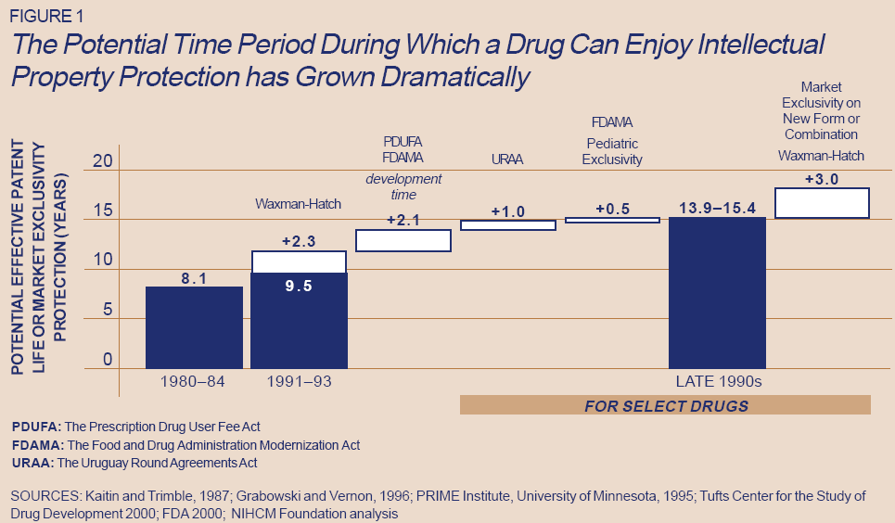

Slide 33
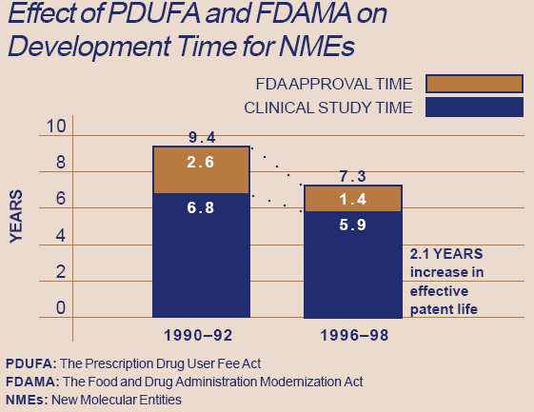

Slide 34
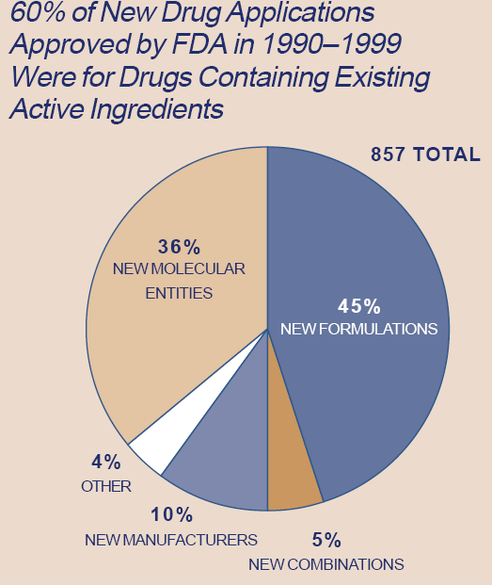
NEW FORMULATION: new dosage or new formulation of active ingredients for drug already on the market.
NEW COMBINATION: drug containing two or more compounds which have been marketed before, but not together as one.
NEW MANUFACTURER: company creating product with the same active ingredients or formulation as another manufacturer.
NEW MOLECULAR ENTITY: compound which has never been sold before in the U.S.

Slide 35
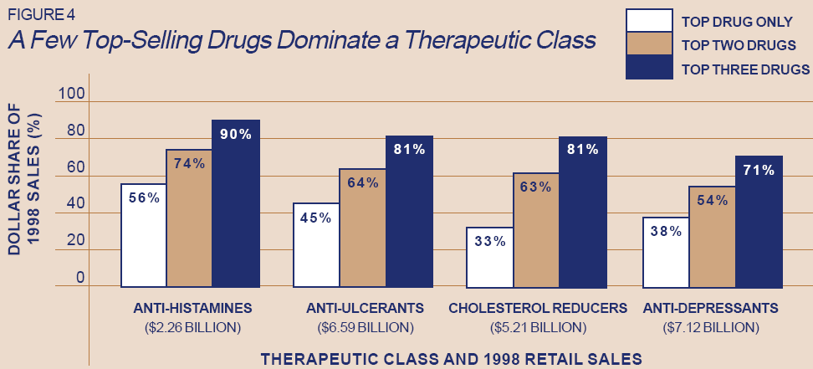
Oligopoly in certain drug markets

Slide 36
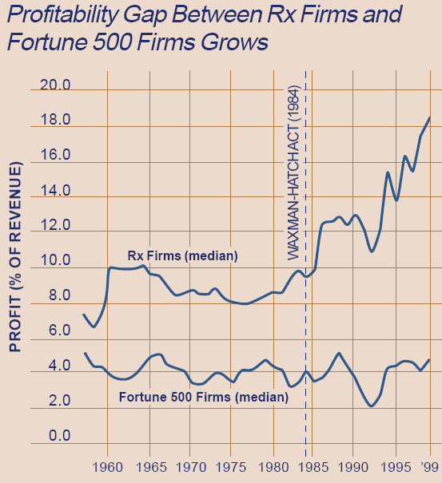

Slide 37
BiDil
http://en.wikipedia.org/wiki/Isosorbide_dinitrate/hydralazine
http://www.nitromed.com/
Patented use – prescription to African-Americans

Slide 38
Neurontin -- promotion of off-label uses. Cultivating doctors.

Slide 39
1997-2004 Fraud/Civil Fines
Against Drug Firms
Roche & BASF
>$725 M
Price fixing cartel
Purdue Pharma
$600 M
Claimed OxyContin less addictive
Allergan
$600 M
Illegal marketing Botox
Noll
$135 M
Suppressing Synthroid research data
Pfizer
$430M & $2.3B
Illegal marketing Neurontin/Bextra
Pfizer
$430M & $2.3B
Illegal marketing Neurontin/Bextra
TAP Pharmaceuticals
$875 M
Criminal kickbacks, Lupron
Novartis
$422 M
Illegal marketing Trileptal
Astra Zeneca
$520 M
Illegal marketing Seroquel
Schering-Plough
$500 M (poor quality)
$345 M + $435 M (fraud)
Eli Lilly
$1.4 B
Illegal marketing Zyprexa
Forest Labs
$313 M
Illegal marketing Lexapro/Celexa
Bayer
$257 M
Criminal Medicaid fraud
Bristol Meyers Squibb
$515 M
Illegal marketing Abilify
Glaxo Smith Kline
$750 M
Defective manufacturing (Paxil)
Sources: NYT 7/30/97, 10/10/99, 1/20/00, 2/4/00, 5/18/02, 4/17/03, 8/30/06, 5/11/07, 9/3/09; Mod HCr 3/25/96, 3/3/97, 10/8/01, 6/30/08, 10/1/10, 10/27/10; Nation 4/7/97; DHHS IG; Phil Inq 7/30/04; USA Today 5/14/04
Sources: NYT 7/30/97, 10/10/99, 1/20/00, 2/4/00, 5/18/02, 4/17/03, 8/30/06, 5/11/07, 9/3/09; Mod HCr 3/25/96, 3/3/97, 10/8/01, 6/30/08, 10/1/10, 10/27/10; Nation 4/7/97; DHHS IG; Phil Inq 7/30/04; USA Today 5/14/04

Slide 40
Angell and Gladwell
Outrageous prices for me-too drugs
Vioxx as example of unneeded heavily-promoted drug
Reforms needed to get rid of conflict of interest affecting doctors and regulators
It's volume, not price.
  Generics are cheaper here.
Docs -- knowledgeable professionals acting as patients’ agents -- prescribed it.
Benefits managers will solve it.

Slide 41
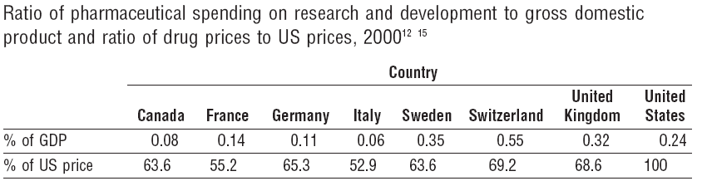
Free riders?
Percentages of world activity
In 2003 | Sales | R&D | NMEs
U.S. | 48% | 49% | 45%
Europe | 28% | 36% | 32%

Slide 42
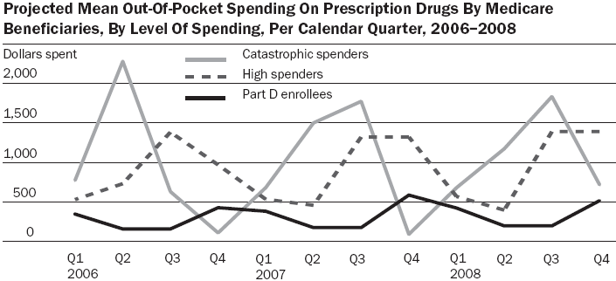

Slide 43
Sleeping Sickness
http://www.who.int/mediacentre/factsheets/fs259/en/index.html
Eflornithine http://www.vaniqa.com/

