Slide 1
Malpractice and torts
Health economics

Slide 2
Localio, A.R., et al, "Relation Between Malpractice Claims and Adverse Events Due to Negligence," N Engl J Med, July 25, 1991, 325(4), pp. 245-251.
Studied 31,429 patients discharged from 51 New York hospitals in 1984.
51 malpractice claims were filed by these patients.
280 adverse events caused by negligence (malpractice)
8 of them filed claims.
No lawsuit in 97% of malpractice incidents
84% of lawsuits – no malpractice
Implies that the tort system is very inefficient at identifying true malpractice, compensating its victims, or disciplining the wrong-doers.

Slide 3
Brennan, T.A., Sox, C.M., Burstin, H.R., "Relation Between Negligent Adverse Events and the Outcomes of Medical-Malpractice Litigation," N Engl J Med, December 26, 1996, 335(26), pp. 1963-1967.
Ten years later (the medical events were in 1984), how did the malpractice cases come out?
No statistical relationship between actual malpractice and outcome of the lawsuit.
The presence of a negligent adverse event (the definition of malpractice) was not a significant predictor of whether the claim was settled in favor of the plaintiff (the patient).
The only significant predictor was the presence of permanent disability.
No-fault compensation for medical injury would be more efficient at getting money to victims.
Peer review better for deterring malpractice.

Slide 4
One student's comment: "This study reminded me of a personal experience that I would like to share. I was an operating room nurse in a small community hospital when two gynecologists joined the staff. Every time these surgeons had a case scheduled, the staff practically drew straws to see who would end up working in the room -- we all dreaded it so much! The majority of the staff felt these two surgeons were incompetent in their surgical endeavors. But, you know what? Patients just loved those doctors. Not because they were superior physicians, but because they both had a wonderful ‘bedside manner!’ It seems that since patients don't really have the knowledge to effectively evaluate the medical care received, they tend to evaluate something that they are quite familiar with -- how they are treated by the physician!"

Slide 5
Claims, Errors, and Compensation Payments in Medical Malpractice Litigation, Studdert et al, N Engl J Med 2006;354:2024-33.
Reviewed a random sample of 1452 closed malpractice claims
3% of the claims had no verifiable medical injuries.
84% of those plaintiffs got no money.
37% did not involve medical errors.
72% of those plaintiffs got no money.
73% of claims that involved injuries due to error did get money.
Claims that did not involve errors or injuries, but that did get paid, got less money than claims with inuries, by about 40%. ($300,000 instead of $500,000)
Claims not involving errors were 13 to 16% of total payments.
For every dollar spent on compensation, 54 cents went to administrative expenses (including lawyers, experts, and courts).
Claims involving errors accounted for 78 percent of total administrative costs.

Slide 6
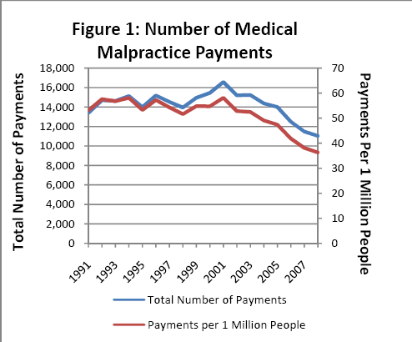

Slide 7
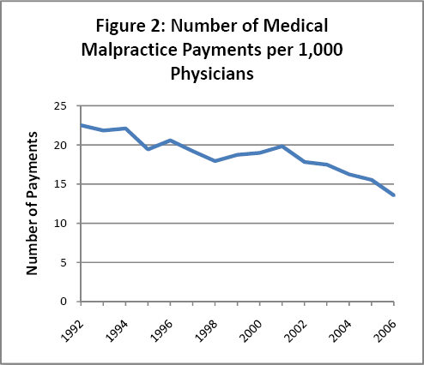

Slide 8
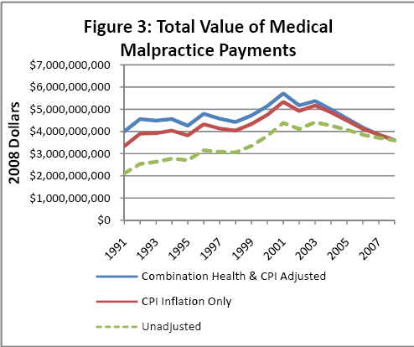

Slide 9
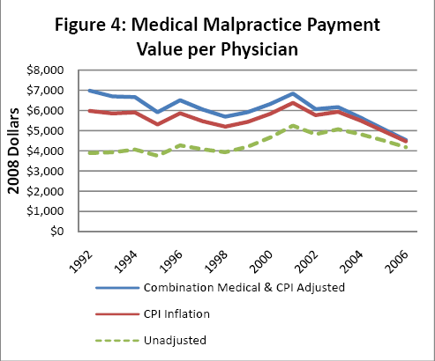

Slide 10
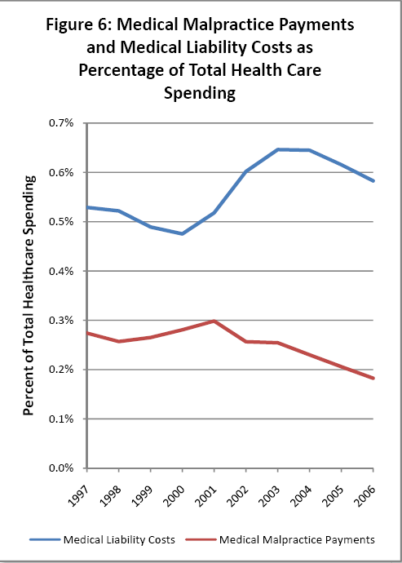

Slide 11
Those malpractice slides are from http://www.citizen.org/documents/NPDB_Report_200907.pdf

Slide 12
Malpractice fading as an issue
http://sg.wsj.net/public/resources/images/NA-BI934_DOCTOR_NS_20101107185602.gif

