Slide 1
Cost
HSPM J712

Slide 2
Cost concepts
Opportunity cost
Total cost
Fixed cost
Variable cost
Average cost
Marginal cost

Slide 3
The economic problem
The basic economic problem is the scarcity of social resources to satisfy human wants and needs.
An economic system must make choices about the allocation of resources among the many possible uses.
The economic system also chooses how the goods and services are distributed -- who gets what.

Slide 4
Cost and the necessity of choice, even in health care
When a high percentage of all spending in our economy is for health care, we wonder if some of the resources going into health care could be better used elsewhere, as
other kinds of health care, that might give more benefit for the same resources
other kinds of health-enhancing investments besides health care, such as education
consumption goods and services that might enhance our lives more than spending on certain kinds of health care would,
or as investments outside of health care that might improve our future ability to produce goods and services more than some investments in health do.

Slide 5
Opportunity cost
Opportunity cost is the most fundamental cost concept.
The opportunity cost of doing or getting something is:
what you could have done or gotten instead

Slide 6
Opportunity cost is what you forgo.
Example: The opportunity cost of buying a box of Cracklin Oat Bran is one-and-a half boxes of Wheat Chex, if that's your second favorite cereal.

Slide 7
Opportunity cost is what you forgo.
Example: Your opportunity cost for taking this class includes:
Whatever else you could have bought with your tuition and fee money
plus
the work, family participation, and recreation that you are not doing because you are here.

Slide 8
Opportunity cost is not resources used
Strictly speaking, the cost of something is not the resources used up to get it.
Instead, the cost is what else you could have done with those resources.
Resources have value only because you can use them to make goods and services that have value.

Slide 9
Using prices for costs
Opportunity cost can be hard to use in practice.
Dollar costs (prices) are
easier to determine
and
easier to add up.

Slide 10
Nevertheless, we should not lose sight of opportunity cost.
Because the price may not reflect the opportunity cost. Possible reasons:
There are costs that do not get paid for.
saving medical care institutional costs by discharging patients early adds opportunity costs for family members who are drafted into being home caregivers

Slide 11
Nevertheless, we should not lose sight of opportunity cost.
Because the price may not reflect the opportunity cost. Possible reasons:
2. There are external costs or benefits.
Like pollution of air, water, or climate

Slide 12
Nevertheless, we should not lose sight of opportunity cost.
Because the price may not reflect the opportunity cost. Possible reasons:
3. A lack of price competition can leave the price well above the opportunity cost.
Hospital services pricing

Slide 13
Money cost concepts
In this section, we assume that we can use dollar costs for costs. Ignore, for now, what we just talked about.
The cost-accounting concepts we’ll discuss:
Total cost
Fixed cost
Variable cost
Marginal cost
Average cost

Slide 14
Stocks and Flows
All these costs are flows
Flow: Goods and services move from one person to another. Flows happen over time.
Stocks: build up or run down

Slide 15
Stocks and Flows Bathtub analogy
Flows
Stock
From faucet
Down the drain
How fast (gallons per minute) the water is coming in or out
Flow per unit of time
Water in the tub
How much water is in the tub right now
Stock at a moment in time

Slide 16
Stocks and Flows in accounting
Flows
Stock
Budget
Income statement
How fast (dollars per year) the money is coming in or out
Flow per unit of time
Balance sheet
Our net worth on a certain date
Stock at a moment in time

Slide 17
Stocks and Flows
Flows
Stock
Income
How fast (dollars per year) the money is coming in or out
Flow per unit of time
Wealth
Our net worth on a certain date
Stock at a moment in time

Slide 18
Stocks and “stocks”
Stock – the creditor’s half of a split tally stick in medieval Europe
http://www.sambaker.com/econ/classes/stocksandflows/stocksandflows.html

Slide 19
Stocks and Flows Opportunity cost is a flow
The opportunity cost of a box of oat cereal
is
What you gave up (or didn’t get) to add that box to your wealth

Slide 20
Total cost
Total cost = TC(Q)
Mathematical function notation
TC(Q) = the total cost of producing Q units of output in a certain amount of time.

Slide 21
Total cost example
Here was the total cost per month of providing different numbers of screening mammograms per day.
This whole table is the total cost
Output rate | 0 | 5 | 10 | 15 | 20 | 30 | 40 | 50
Mammograms/day
Total cost per month | $6,172 | $9,462 | $10,337 | $13,627 | $14,502 | $18,667 | $20,417 | $22,167

Slide 22
Example
Source: Physician Payment Review Commission, The Costs of Providing Screening Mammography, 1989. This study was done just after Medicare started paying for screening mammograms.

Slide 23
Screening mammography costs, 1989
Output rate Mammograms/day | Total cost per month
0 | $6,172
5 | $9,462
10 | $10,337
15 | $13,627
20 | $14,502
30 | $18,667
40 | $20,417
50 | $22,167

Slide 24
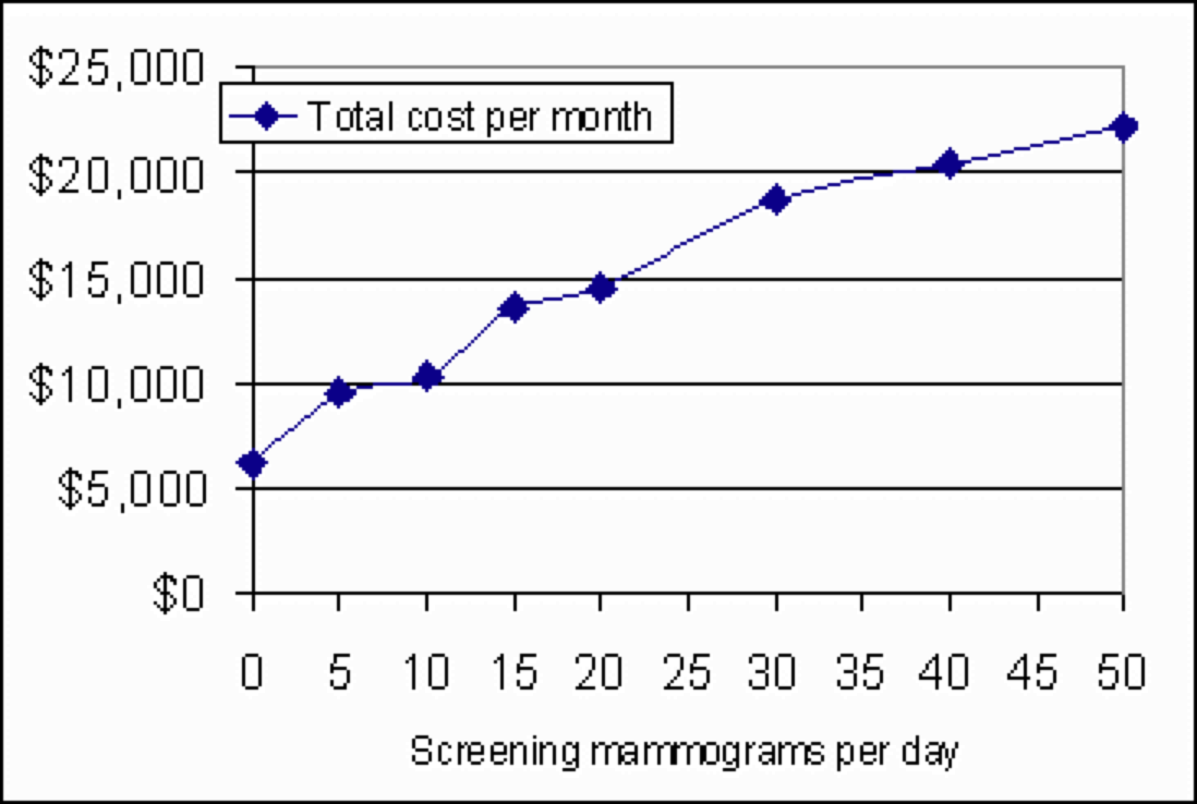
Total cost is an increasing function of quantity. The faster you produce, the more your total cost at that rate.

Slide 25
The cost of producing 0 is not $0. The cost of producing 0 is the fixed cost.

Slide 26
Fixed cost
Fixed cost is the cost of producing 0 output in a given time period.
Fixed costs are costs that can't be avoided in the "short run"
"Short run" means a time period in which fixed costs can't be avoided.
(Circular?)

Slide 27
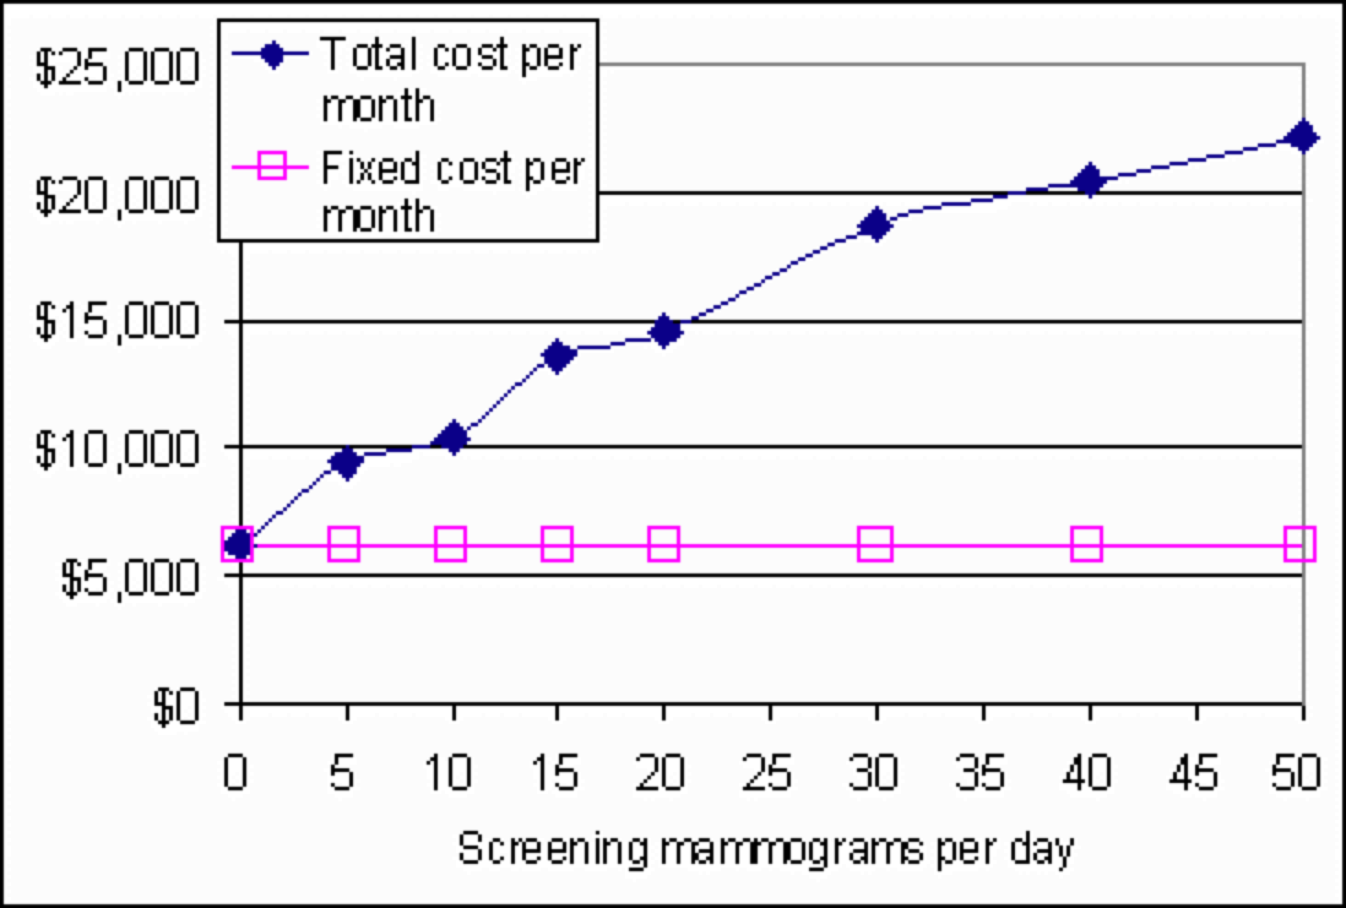
Fixed cost is a function of Quantity per unit of time in the trivial sense that it's a constant function. Fixed cost’s line goes straight across.

Slide 28
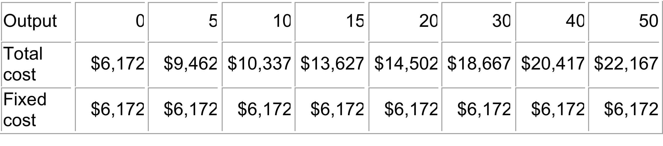
Total and fixed cost
In a table, fixed cost is "fixed" -- the same -- at all output rates

Slide 29
Capital outlay required before the first patient is seen:
Mammography unit and processor | $80,000
Start-up supplies | $2,000
Property improvements | $15,000
Furniture | $5,000
Office equipment | $3,500
Miscellaneous | $500
Capital outlay -- total of above | $106,000
What’s in
fixed cost.
Part is because
of the capital
needed.

Slide 30
Converting a stock to a flow
The capital outlay is a stock, rather than a flow.
To use our cost concepts, we have to convert it to a flow. Imagine that we borrow the $106K and intend to pay it back at so many dollars per month. That "so many dollars" per month is part of our fixed cost flow.
Amortized capital cost per month, at a 12% interest rate for 6 years is $2,072. This is the monthly fixed cost flow associated with our initial capital outlay.

Slide 31
Expenses that happen even if no customers show
Other fixed costs per month
Maintenance | $425
Promotion | $250
Accounting | $100
Insurance | $100
Rent | $875
Telephone | $100
Taxes | $750
Clerk/Receptionist salary and benefits | $1,500
TOTAL other fixed costs per month | $4,100

Slide 32
Fixed cost summary
Monthly capital cost | $2,072
Recurring fixed cost | $4,100
Total fixed cost -- flow per month | $6,172

Slide 33
Fixed cost is $6172.

Slide 34
Variable Cost
Variable cost equals total cost minus fixed cost.
The variable cost is extra cost of producing Q, above the cost of producing 0.
In the "long run," all costs are variable.

Slide 35
Variable costs per month (20 working days per month)
 |  | Tests per day
Cost category | Unit cost | 5 | 10 | 15 | 20 | 30 | 40 | 50
Radiological technologist |  | $2,415 | $2,415 | $4,830 | $4,830 | $7,245 | $7,245 | $7,245
Film | $3.00 | $300 | $600 | $900 | $1,200 | $1,800 | $2,400 | $3,000
Medical Records | $2.00 | $200 | $400 | $600 | $800 | $1,200 | $1,600 | $2,000
Supplies and miscellaneous | $2.00 | $200 | $400 | $600 | $800 | $1,200 | $1,600 | $2,000
Postage | $1.00 | $100 | $200 | $300 | $400 | $600 | $800 | $1,000
Forms | $0.75 | $75 | $150 | $225 | $300 | $450 | $600 | $750
Total monthly variable cost |  | $3,290 | $4,165 | $7,455 | $8,330 | $12,495 | $14,245 | $15,995
(all above added up)

Slide 36
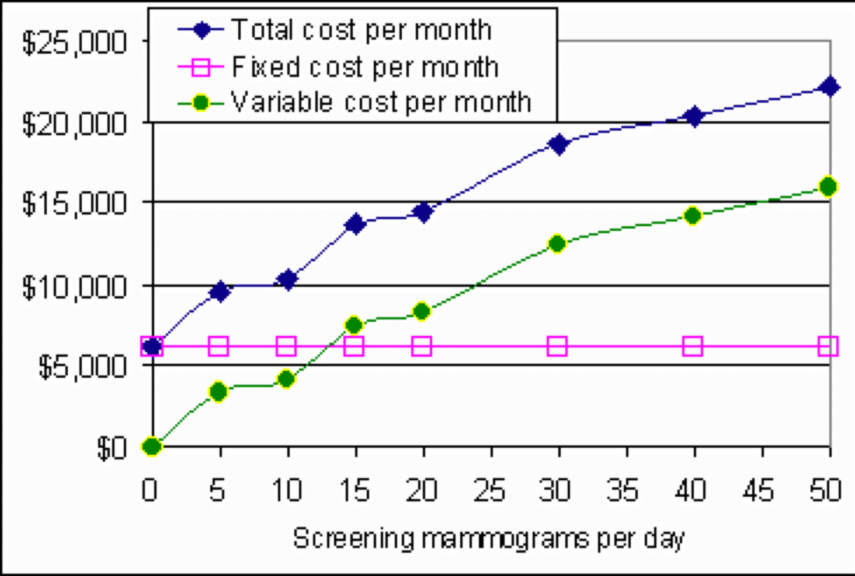

Slide 37
Marginal cost Incremental cost
Marginal cost is
Total cost at output Q
minus
total cost at output Q-1.
Marginal cost is the additional cost of producing one more.
Or the reduction in cost from producing one less.

Slide 38
Calculating marginal cost
… is a bit tricky, because the radiological technologist is "lumpy."
"Lumpy" means not continuously variable.
The technologist is somewhat of a fixed cost over some mall changes in output rate,
Apparently, you can only hire full-time technologists, not part-time, which would reduce the lumpiness.

Slide 39
Variable costs per month (20 working days per month)
 |  | Tests per day
Cost category | Unit cost | 5 | 10 | 15 | 20 | 30 | 40 | 50
Radiological technologist |  | $2,415 | $2,415 | $4,830 | $4,830 | $7,245 | $7,245 | $7,245
Film | $3.00 | $300 | $600 | $900 | $1,200 | $1,800 | $2,400 | $3,000
Medical Records | $2.00 | $200 | $400 | $600 | $800 | $1,200 | $1,600 | $2,000
Supplies and miscellaneous | $2.00 | $200 | $400 | $600 | $800 | $1,200 | $1,600 | $2,000
Postage | $1.00 | $100 | $200 | $300 | $400 | $600 | $800 | $1,000
Forms | $0.75 | $75 | $150 | $225 | $300 | $450 | $600 | $750
Total monthly variable cost |  | $3,290 | $4,165 | $7,455 | $8,330 | $12,495 | $14,245 | $15,995
(all above added up)

Slide 40
The other marginal costs total $8.75 per patient
Cost category | Unit cost
 | (cost per mammogram)
Film | $3.00
Medical Records | $2.00
Supplies and miscellaneous | $2.00
Postage | $1.00
Forms | $0.75
The physician’s fee is billed separately, so it’s not included here.

Slide 41
You make money if your price is more than your marginal cost.
$8.75 is the marginal cost of a screening mammogram if the technologist is not fully busy.
If a woman walks in unexpectedly and offers $8.76 for a screening mammogram, and your technologist is not busy, then you can make $0.01 by doing a mammogram for her.

Slide 42
If you need to add a technologist, the marginal cost is higher.
If you are doing 10 mammograms a day, and you are considering signing a contract to provide, say, 5 more mammograms per day, $8.75 will not be your marginal cost per mammogram, because you will have to add a technologist.
For the table that follows, I’ve considered only output rates 0, 5, 10, 15, etc., to simplify the calculation.

Slide 43
Tests per day | 0 | 5 | 10 | 15 | 20 | 30 | 40 | 50
Tests per month | 0 | 100 | 200 | 300 | 400 | 600 | 800 | 1000
Total cost | $6,172 | $9,462 | $10,337 | $13,627 | $14,502 | $18,667 | $20,417 | $22,167
Fixed cost | $6,172 | $6,172 | $6,172 | $6,172 | $6,172 | $6,172 | $6,172 | $6,172
Technologists | 0 | 1 | 1 | 2 | 2 | 3 | 3 | 3
needed
Variable cost | $0 | $3,290 | $4,165 | $7,455 | $8,330 | $12,495 | $14,245 | $15,995
Marginal cost | Not | $3,290 | $875 | $3,290 | $875 | $4,165 | $1,750 | $1,750
from previous output rate | applicable
Corresponding | Not | $32.90 | $8.75 | $32.90 | $8.75 | $20.83 | $8.75 | $8.75
marginal cost per unit | applicable

Slide 44
The lumpiness of the technologist makes the marginal cost jump up or down, depending on whether we do or do not have to add a technologist to achieve the next higher output rate. The marginal cost is high when we have to add a technologist. It's low otherwise.
The next slide assumes that we can change the output rate only by a multiple of 5 per day.

Slide 45
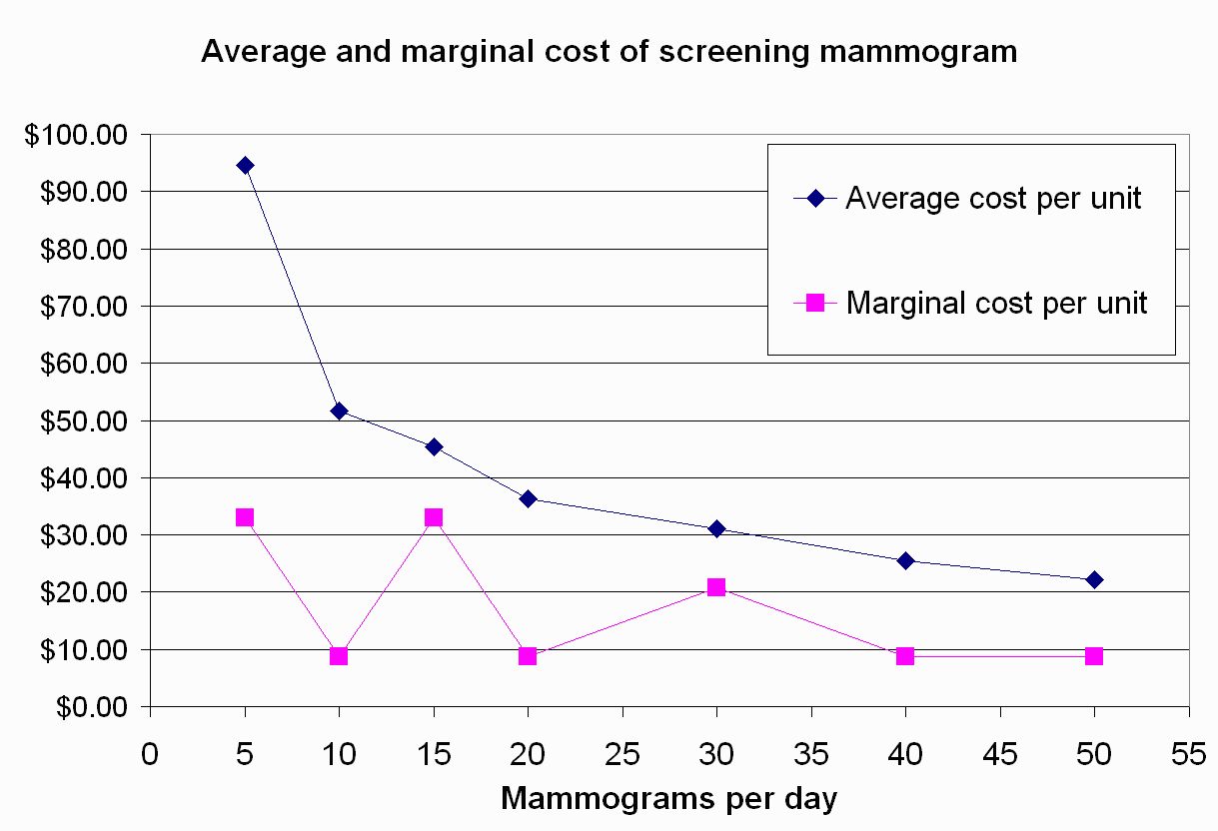

Slide 46
Marginal cost and your minimum price
Tests per day | 0 | 5
Tests per 20-day month | 0 | 100
Total cost | $6,172 | $9,462
Fixed cost | $6,172 | $6,172
Technologists needed | 0 | 1
Variable cost | $0 | $3,290
Marginal cost from previous output level | Not applic-able | $3,290
Corresponding marginal cost per unit | Not applic-able | $32.90
(row above divided by 100 tests per day)
If you’re seeing nobody, and you want to contract for doing 5 visits a day,
Your price must be at least $32.90 per mammogram, if you want to gain money from the contract.

Slide 47
Tests per day | 30 | 40
Tests per 20-day month | 600 | 800
Total cost | $18,667 | $20,417
Fixed cost | $6,172 | $6,172
Technologists needed | 3 | 3
Variable cost | $12,495 | $14,245
Marginal cost from previous output level | $4,165 | $1,750
Corresponding marginal cost per unit | $20.83 | $8.75
If you're currently doing 30 tests per day, you can make money if you can get a price above $8.75 each for additional tests.

Slide 48
Marginal cost is the concept to use when considering changes.
Compare the costs with the change to the cost without the change.
The difference is the marginal cost of the change.
Compare that with the marginal benefit of the change to decide whether the change is advantageous.

Slide 49
Average cost
Average cost is
Average cost is sometimes mistakenly used in place of marginal cost.
The upcoming Stool Guaiac test article shows an example of that confusion.

Slide 50
Average cost
Marginal cost is what to use to decide whether to do something.
Average cost is good for telling you whether you're making money overall.
Revenue is the total amount you take in.
Profit = Revenue minus cost.

Slide 51
If you charge all customers the same price
(in health care, you generally don't. But, suppose you did.)
Revenue = Price times Quantity.

Slide 52
If Price exceeds Average Cost then your unit profit is positive. You’re making money.
If the price is less than the average cost, your average profit per unit is negative. You’re losing money.

Slide 53
Average cost
Tests per day | 0 | 5 | 10 | 15 | 20 | 30 | 40 | 50
Tests per month | 0 | 100 | 200 | 300 | 400 | 600 | 800 | 1000
Total cost | $6,172 | $9,462 | $10,337 | $13,627 | $14,502 | $18,667 | $20,417 | $22,167
Average cost | (Can't divide | $94.62 | $51.69 | $45.42 | $36.26 | $31.11 | $25.52 | $22.17
 | by 0.)
Economies of scale. AC falls as Q rises. That’s because the fixed cost gets spread over more tests.

Slide 54
Average cost and marginal cost
Tests per day | 0 | 5 | 10 | 15 | 20 | 30 | 40 | 50
Tests per month | 0 | 100 | 200 | 300 | 400 | 600 | 800 | 1000
Total cost | $6,172 | $9,462 | $10,337 | $13,627 | $14,502 | $18,667 | $20,417 | $22,167
Average cost | Can't divide | $94.62 | $51.69 | $45.42 | $36.26 | $31.11 | $25.52 | $22.17
 | by 0
Marginal cost | Not | $3,290 | $875 | $3,290 | $875 | $4,165 | $1,750 | $1,750
from previous output level | applic-able
Corresponding | Not | $32.90 | $8.75 | $32.90 | $8.75 | $20.83 | $8.75 | $8.75
marginal cost per unit | applic-able

Slide 55
In the 40 column:
The marginal cost per test is $8.75,
but the average cost is $25.52.
Can we really provide extra tests at a price just over $8.75 each and make money?
Yes, if we don't have to charge all our customers that price.
Offering a group a price just above its marginal cost will let us make money on that group.
But if we offer all customers prices just above their marginal costs, we won't cover our fixed costs, so we'll lose money overall.

Slide 56
Price discrimination
Jargon term for charging different customers different prices.
Not illegal.
In health care, often encouraged.
Sliding scale fees for doctors
Payment plans and write-offs for hospitals
Drug samples
Negotiated contracts with insurers

Slide 57
Average cost is the break-even price
Tests per day | 0 | 5 | 10 | 15 | 20 | 30 | 40 | 50
Tests per month | 0 | 100 | 200 | 300 | 400 | 600 | 800 | 1000
Total cost | $6,172 | $9,462 | $10,337 | $13,627 | $14,502 | $18,667 | $20,417 | $22,167
Average cost | Can't divide | $94.62 | $51.69 | $45.42 | $36.26 | $31.11 | $25.52 | $22.17
 | by 0
Marginal cost | Not | $3,290 | $875 | $3,290 | $875 | $4,165 | $1,750 | $1,750
from previous output level | applic-able
Corresponding | Not | $32.90 | $8.75 | $32.90 | $8.75 | $20.83 | $8.75 | $8.75
marginal cost per unit | applic-able
At 40 tests per day, the break-even price is $25.52. Any higher price Is profitable.

Slide 58
Long-run and short-run
In the short run, it pays to sell to any customer who'll pay marginal cost.
Even if you’re losing money overall, you're losing less than if you had turned down the sale.
In the long run, when you can get out of your fixed cost, you shut down if your average price is not more than average cost.

Slide 59
Review
Opportunity cost is
what you give up to get something

Slide 60
Review of money cost concepts
Total cost -- the dollars you give up by being in business and operating at your current rate.
Fixed cost -- the dollars you give up by being in business, even if you produce nothing.
Variable cost -- the dollars you give up to produce at your current rate, over and above your fixed cost.
All these costs are “flows.” $ per time period.

Slide 61
Review of money cost concepts
Marginal cost -- the dollars you give up to add one to your rate of production.
Average cost -- total cost divided by output rate

Slide 62
Review
Price discrimination is
Charging different customers different prices for the same thing.

Slide 63
When the price does not reflect the opportunity cost
There are costs that do not get paid for.
There are external costs or benefits.
A lack of price competition can leave the price well above the opportunity cost.

Slide 64
Hospital day price example
Reinhardt, in this week’s assigned article, argues that
Prices for hospital days late in a patient’s stay are higher than opportunity cost.
This leads to substituting other forms of care that have higher opportunity cost.

Slide 65
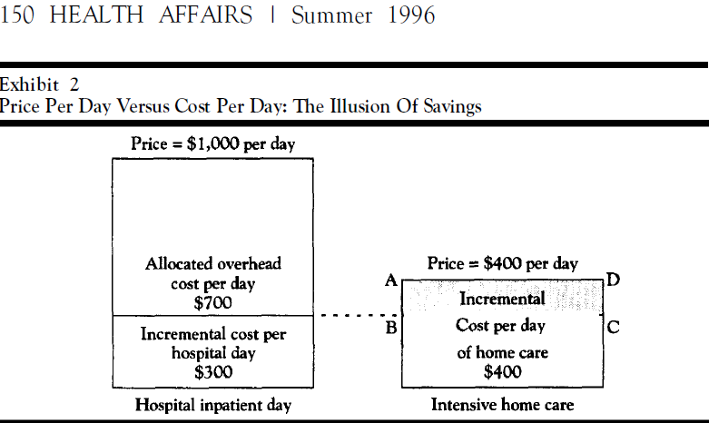

Slide 66
Emergency room care – Pricey? Costly?
Trauma care is pricey and costly
Primary care in the E.R.
Pricey
Not costly

Slide 67
Emergency room care – Pricey? Costly?
Primary care in the E.R.
Pricey, because of Ramsay Principle.
Demand is inelastic. Hospitals can raise the price without driving customers away.
Not costly, because
The E.R. has to have people on duty at all times, ready to care for serious trauma and life-threatening illness at a moment’s notice.
When they’re not busy doing that, they take care of non-urgent patients in the waiting room.

Slide 68
Spending and cost
Diverting people from the E.R. to doctors’ offices would raise cost but reduce spending.
Spending is price X quantity

Slide 69
Brown et al on screening mammogram supply and pricing
Lacking competition over price …
… many providers persisted in the market with high cost and prices
The high prices reduced the quantity demanded to less than the Need.

Slide 71
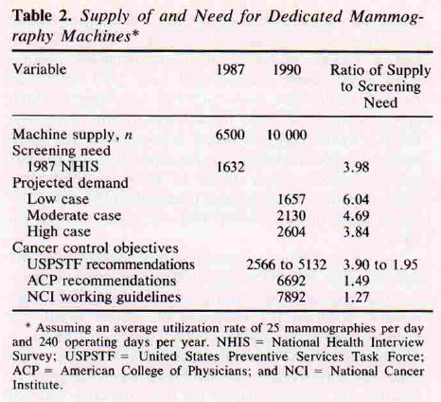

Slide 72
Price and Cost are different concepts
Price
what you pay
Cost
what you – or we – give up

