Slide 1
Lecture 5
HSPM J716

Slide 2
Assignment 4
Answer checker
Go over results

Slide 3
Regression results
AFDCUP% is the dependent variable, with a mean of 0.2412897
Variable Coefficient Std Error T-statistic P-Value
Intercept -0.9057769 0.1748458 -5.1804336 0.000001
UE_RATE 0.0782032 0.0060869 12.847859 0
UI_AVG -6.8115E-6 7.7298E-4 -0.008812 0.9929849
INCOME -3.1385E-5 7.5487E-6 -4.1576947 0.0000635
HIGH% 0.0089853 0.0024679 3.64082 0.0004144
NEED 2.6713E-4 1.6131E-4 1.6559912 0.100548
PAYMENT 3.467E-4 2.0871E-4 1.6611253 0.0995103

Slide 4
Simple Correlations
AFDCUP%
AFDCUP% 1.0
UE_RATE 0.7830068
UI_AVG 0.4676926
INCOME 0.0227082
HIGH% -0.1572882
NEED 0.4132545
PAYMENT 0.2918186

Slide 5
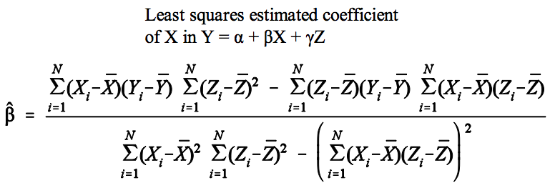
Multiple regression coefficient and multicollinearity
If Z=aX+b, the numerator and the denominator both become 0.

Slide 6
Standard error of coefficient → ∞ T-value → 0 if Z=aX+b

Slide 7
F-test

Slide 8
Prediction
Total is the prediction: -0.0484518
90% conf. interval is -0.2402759 to 0.1433724
The predicted number of families in SC 1,700,000 x -0.0484518 x 0.01 = -823.6806
The top end of the 90% confidence interval
1,700,000x 0.1433724 x 0.01 = 2437.33

Slide 9
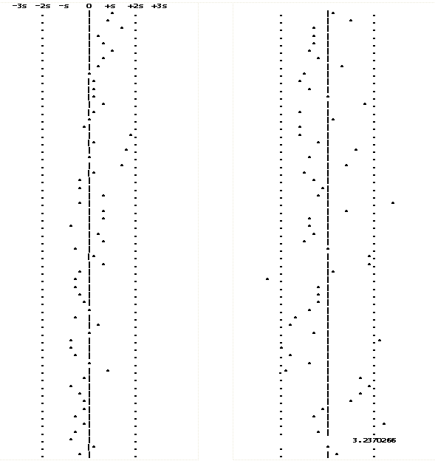

Slide 10
Heteroskedasticity
Heh’-teh-ro – ske-das’ – ti’-si-tee
Violates assumption 3 that errors all have the same variance.
Ordinary least squares is not your best choice.
Some observations deserve more weight than others.
Or –
You need a non-linear model.

Slide 11
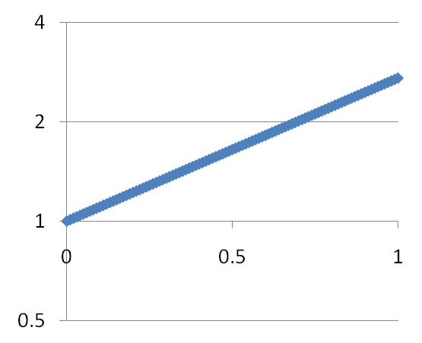
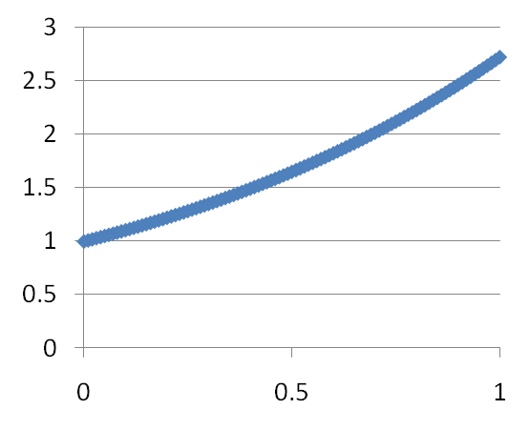
Nonlinear models – adapt linear least squares by transforming variables
Y = e^{x}
Made linear by New Y = logarithm of Old Y.

Slide 12
e
Approx. 2.718281828
Limit of the expression below as n gets larger and larger

Slide 13
Logarithms and e
e⁰=1
Ln(1)=0
eªe^{b}=e^{a+b}
Ln(ab)=ln(a)+ln(b)
(e^{b})a=e^{ba}
Ln(bª)=aln(b)

Slide 14
Transform variables to make equation linear
Y = Ae^{bx}u
Ln(Y) = ln(Ae^{bX}u)
Ln(Y) = ln(A) + ln(e^{bX}) + ln(u)
Ln(Y) = ln(A) + bln(e^{X}) + ln(u)
Ln(Y) = ln(A) + bX + ln(u)

Slide 15
Transform variables to make equation linear
Y = AX^{b}u
Ln(Y) = ln(AX^{b}u)
Ln(Y) = ln(A) + ln(X^{b}) + ln(u)
Ln(Y) = ln(A) + bln(X) + ln(u)

Slide 16
Logarithmic models
Y = Ae^{bx}u
Y = Ax^{b}u
Constant growth rate model
Continuous compounding
Y is growing (or shrinking) at a constant relative rate of b.
Linear Form
ln(Y) = ln(A) + bX + ln(u)
U is random error such that
ln(u) conforms to assumptions
Constant elasticity model
The elasticity of Y with respect to X is a constant, b.
When X changes by 1%, Y changes by b%.
Linear Form
ln(Y) = ln(A) + bln(X) + ln(u)
U is random error such that
ln(u) conforms to assumptions

Slide 17
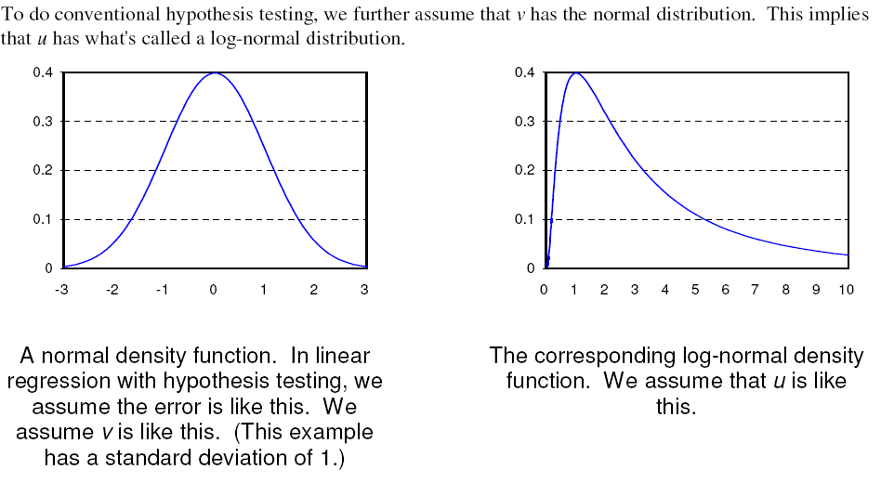
The error term multiplies, rather than adds. Must assume that the errors’ mean is 1.

Slide 18
Demos
Linear function demo
Power function demo

Slide 19
Assignment 5

